Slide 1


Linked List
In Data Structures

Slide 2
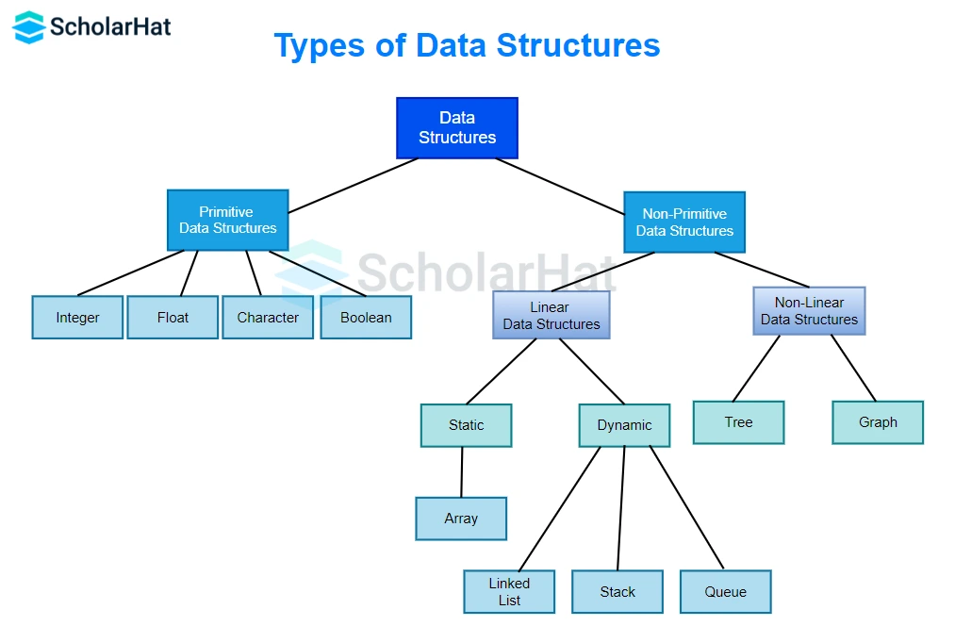

Slide 3


1) What is a Linked List?
2) Types of Linked List.
3) Operations on Linked List.
4) Advantages of Linked List.
5) Disadvantages of Linked List.

Slide 4
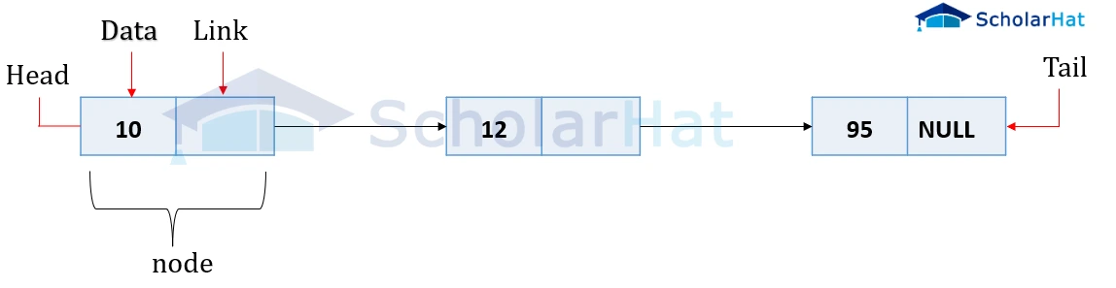
1) What is a Linked List?
Is a data structure used to store a sequence of elements. Each element in the list is called a "node," and each node contains two main parts: the data value and a pointer (Link).
Pointer : is a crucial component of each node that is used to reference the next node in the sequence.

Slide 5
2) Types of Linked List.
There are two main types of linked lists:
1. Singly Linked List:
=> Each node contains a data value and a pointer to the next node.
=> The last node contains a pointer to ‘null’ , indicating the end of the list.

Slide 6
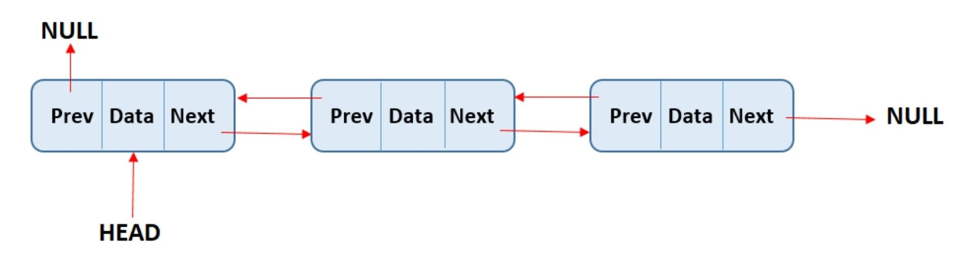
2) Types of Linked List.
2. Doubly Linked List:
=> Each node contains a data value and a pointer to the next node.
=> The last node contains a pointer to ‘null’ , indicating the end of the list.

Slide 7
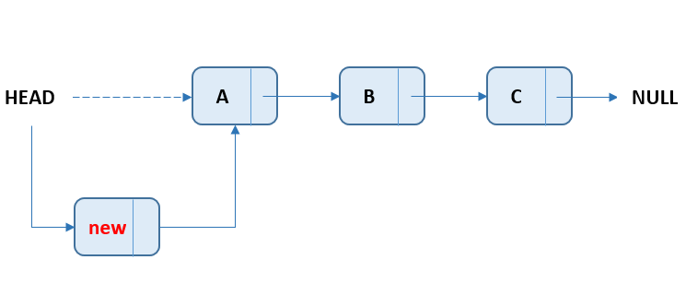
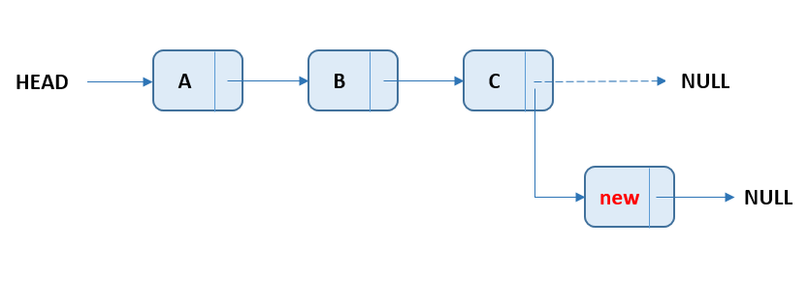
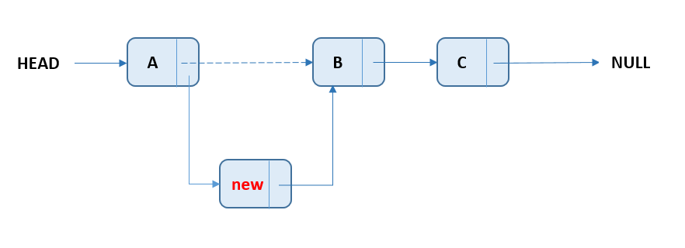
3) Operations on Linked List.
1) Insertion:
At the Beginning: Add a new node at the start of the list.
At the End: Add a new node at the end of the list.
After a Given Node: Insert a new node after a specified node.

Slide 8
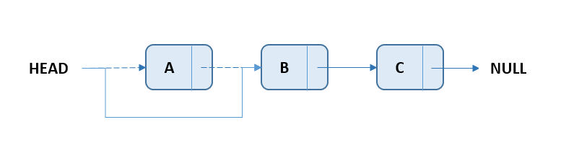
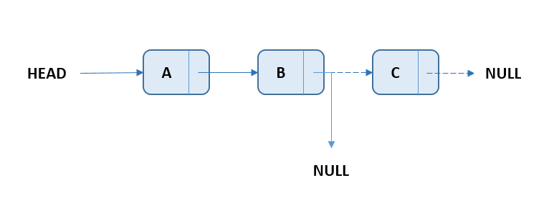
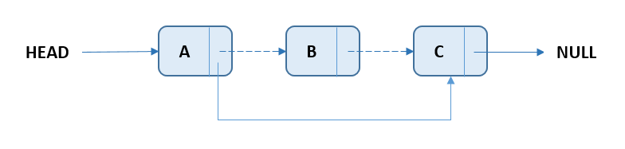
3) Operations on Linked List.
2) Deletion:
From the Beginning: Remove the node from the start of the list.
From the End: Remove the node from the end of the list.
After a Given Node: Remove the node after a specified node.

Slide 9
3) Operations on Linked List.
3) Traversal/Display: Traverse through the linked list to access each element sequentially.
4) Search: Search for an element in the linked list.
5) Update: Update the value of an existing node.

Slide 10
4) Advantages of Linked List.
1) Flexibility:
Elements can be easily added or removed without the need to shift other elements, as is the case with arrays.
2) Efficiency:
Insertion and deletion operations can be faster in some cases compared to arrays, especially for large lists.

Slide 11
5) Disadvantages of Linked List.
1) Memory Consumption:
Each node contains an extra pointer (or two in doubly linked lists), which increases memory usage.
2) Access Time:
Accessing a specific element requires traversing all preceding elements, making search operations less efficient compared to arrays.

